Slide 1
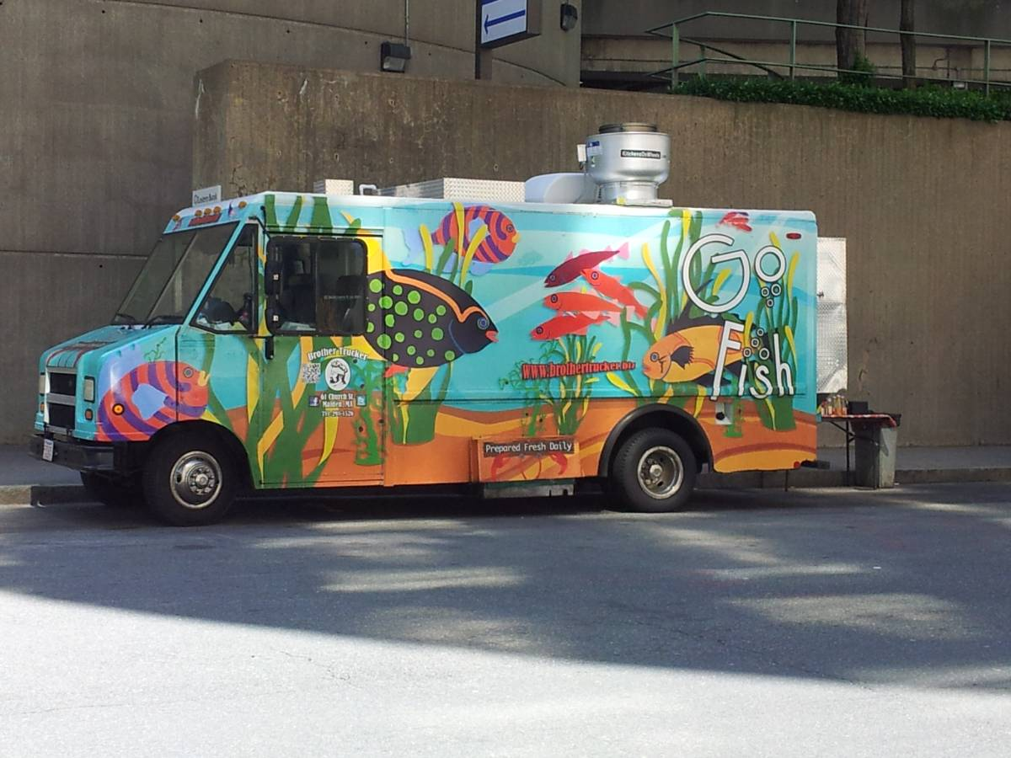
Operations and Best Practices
Mobile Food Facility

Slide 2
Personal Hygiene
Employee Health Policy
  Employees ill with diarrhea, fever, vomiting, jaundice, sore throat, or discharge from eyes may not work with exposed food, utensils, linens or service items Cuts and sores must be covered (ex: finger cot/bandage) and gloves must be worn over the cover
Hand wash facilities (Portable hand wash stations)
  Hand sinks must have running water of (100 F), dispensed soap, paper towels, hand wash signs and a wastebasket
    MFF type 1 (packaged goods) may use moist towelettes/sanitizer
    MFF type 2 (Commercially processed packaged food) may use a portable hand wash station or towelettes/sanitizer may be used if product is in secure packaging
    MFF type 3 & 4 (kitchen on wheels) must have a conveniently located and accessible hand wash sink—complete with hot and cold running water
Clothing
  Hair restraints and clean clothing are required, Aprons may be worn
Gloves
  Gloves are not required, but hands may NOT touch ready-to-eat food. If worn, gloves should be used for one task only and discarded when damaged or when changing or interruption of activities

Slide 3
Food Protection
No food/paper products are to be prepared or stored in private homes, unless in a separate refrigerator/storage area away from personal items.
Home processed/canned food is not allowed unless the home operation is licensed as a Limited Food Producer by the PA Department of Agriculture
Food at least 6 inches off ground/floor
Food to be stored in food grade containers only
Keep ready-to-eat foods separate from raw foods
Condiments must be dispensed in individual packets, squeeze bottles or served by the employee
Thermometers must be on-site for monitoring temperatures
Protect food from insects, rodents and other environmental contamination
Any ice used for cooling must be kept frozen/no food allowed in standing water
Keep chemicals away from food
All chemical containers must be labeled
Keep garbage in a water-tight container with a lid
All MFF’s (mobile food facilities) must have overhead protection (truck roof, canopy, umbrella, etc.)
The food storage and prep areas must be protected and secured from public access
Receipts for all wholesale food purchases must be available upon request

Slide 4

Temperature: Stay Out of
“The Danger Zone”
Foods must be kept at 41F or colder in cold holding
Foods must be kept at 135F or hotter in hot holding
Temperatures between 41F and 135F can allow for rapid growth of harmful bacteria
(the danger zone!)
Foods may be thawed in the refrigerator, under cool running water or in the microwave (if cooked immediately after).
Do not let food sit out on the counter or in sink to thaw
Food which has been cooked and cooled must be reheated to at least 165F within two (2) hours before being placed back into hot holding

Slide 5


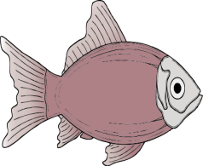


What’s Cookin’
(how long? & how high?)
Poultry, stuffed meats, stuffed fish or stuffed pasta
165F (74C) for 15 Seconds
Ground Beef
155F (68C) for 15 seconds
Beef Steak, veal, lamb, pork, fish, shell eggs
145F (63C) for 15 seconds

Slide 6
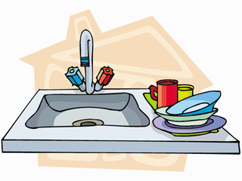
Cleaning/Sanitizing
Warewashing
A three-compartment sink with air-dry drain boards (or area to air dry) is required for MFF types 3 and 4
Any other warewashing set up must be approved by the health officer in advance of the event
Sanitizing
All food contact surfaces must be cleaned and sanitized at least every 4 hours
There are several chemical sanitizers available. (Chlorine, Quaternary Ammonium Compounds (Quats) and Iodine
A spray bottle or clean wiping cloths stored in a sanitizer bucket may be used on surfaces
PH test strips for the type of sanitizer must be used
Sponges are not allowed to be used to clean food contact surfaces

Slide 7

Water/Wastewater/Electricity
All water used must be from an approved source (municipal supplier)
Commercially bottled water may be used
If non-municipal water is used it must be tested for Total Coliform and Nitrate/Nitrites before usage
The materials used for the MFF water tanks must be safe, durable, corrosion-resistant and have a smooth-easy to clean surface
Water hoses for drinkable water should be labeled to prevent contamination
Hoses must also be labeled by manufacturer as “food grade”
Dispose of Wastewater properly into a plumbed sewer
The City of Harrisburg will not be providing access to water. Vendors must provide all connections, filters, and hoses.
Access to water can be made through Capital Region Water by calling 717.236.4098
Electrical services must also be provided by the vendor. For more information about electrical services: contact *** at 717.***.****

Slide 8
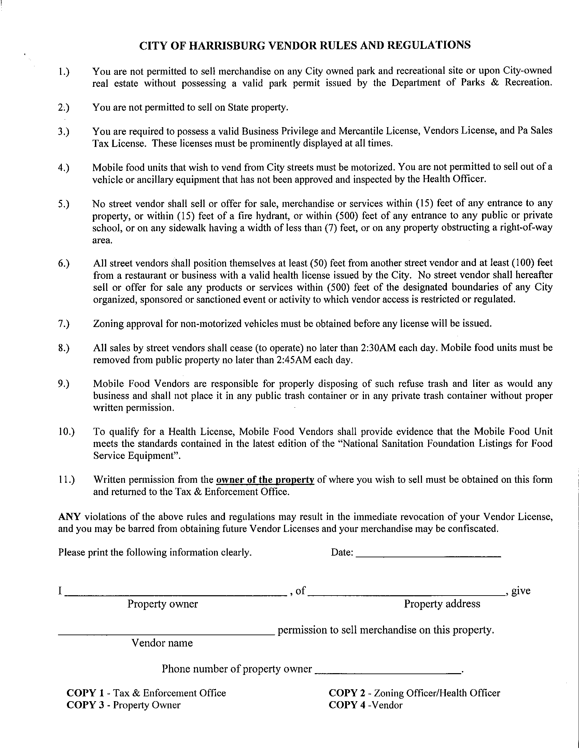
Rules/Regulations

Slide 9

Questions/Contacts
Nelva Wright, Health Officer
Megan Roby, Special Event Marketing
Michael Hughes, Mercantile License Office
Ben Weirick, PA Department of Agriculture
Geoff Knight, Zoning Department

